Slide 1
Care partner training
DEVELOPED WITH Dr. Jori Fleisher
January 2025

Slide 2
Communication Tools

Slide 3
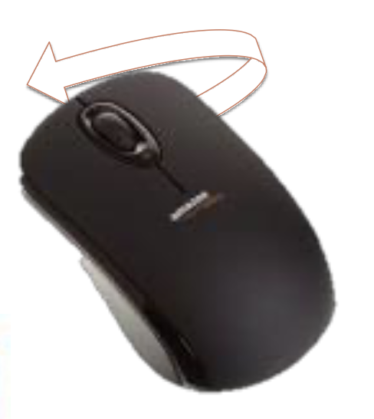


HANDWRITING

Slide 4
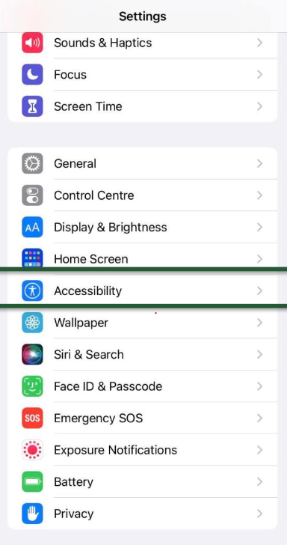
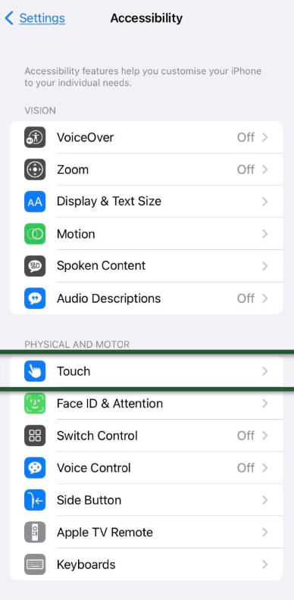

ADJUSTING iPHONE SETTINGS
SETTINGS

Slide 5
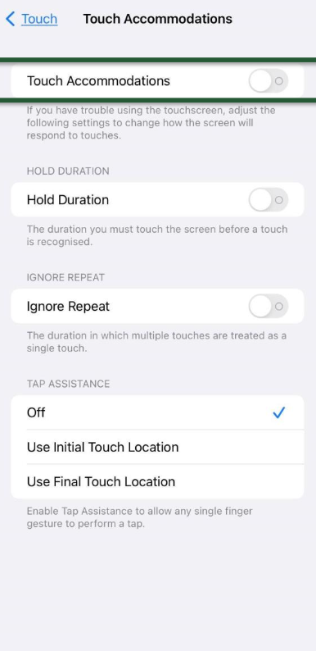
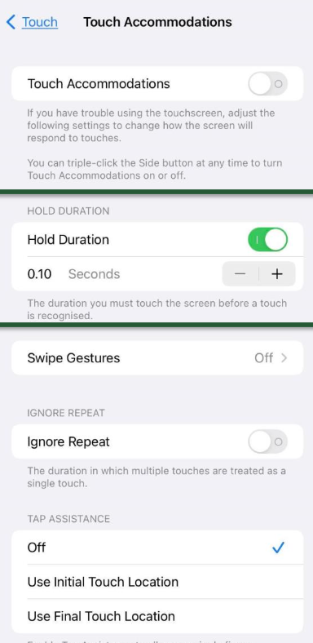
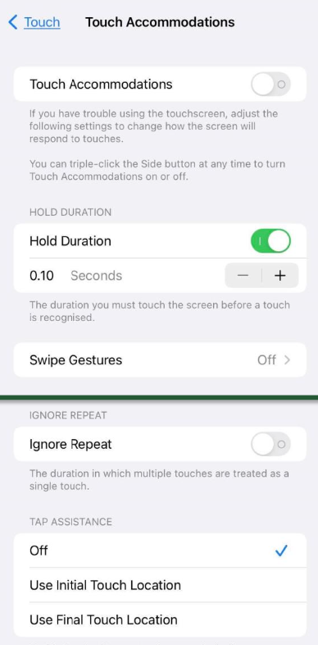
ADJUSTING iPHONE SETTINGS

Slide 6


COMMUNICATION

Slide 7

COMMUNICATION
Google “communication board” for a host of different versions to print, copy, & laminate

Slide 8
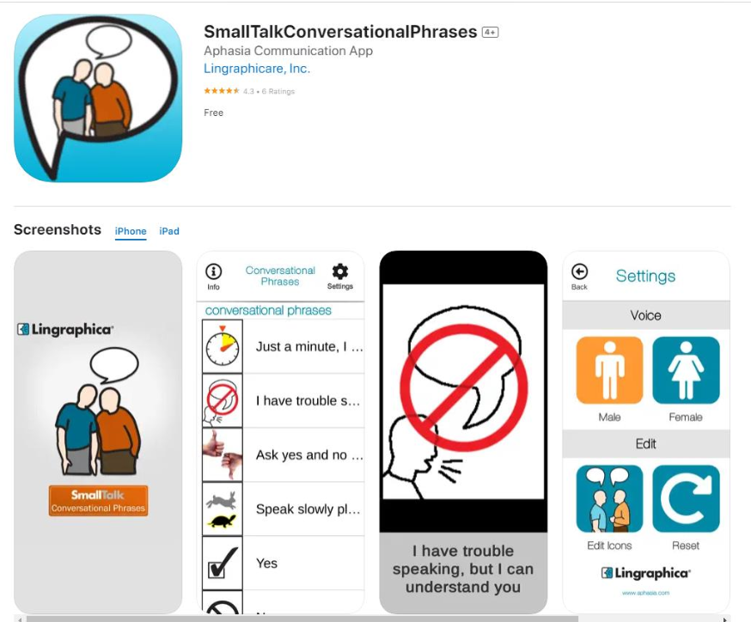
COMMUNICATION
Search the App Store or wherever you download applications for
“SmallTalkConversationalPhrases”

Slide 9
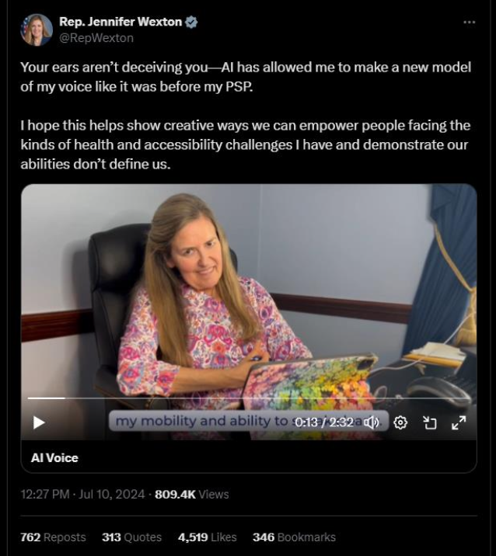
COMMUNICATION
Representative Wexton speaking with AI voice model
Coming Soon…

Slide 10
Transfers & Mobility

Slide 11

TRANSFERS
THE PLASTIC BAG TRICK

Slide 12
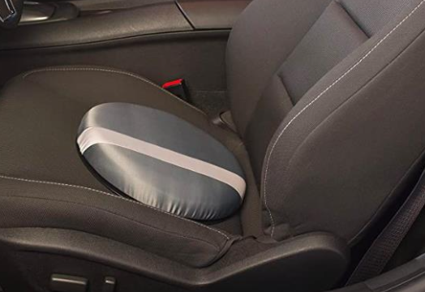
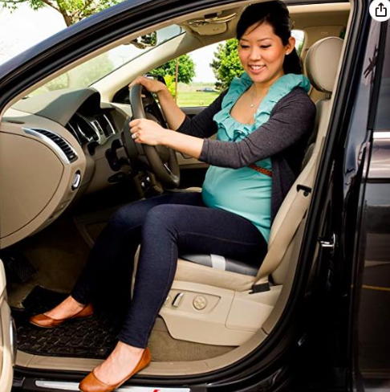
TRANSFERS
$$ Version of The Plastic Bag Trick: Lazy Susan/Steven
Swivel Seat Cushion
(Amazon)
Bonus – you can use on other non-swiveling chairs at home!

Slide 13
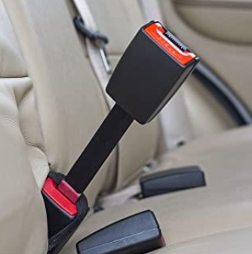
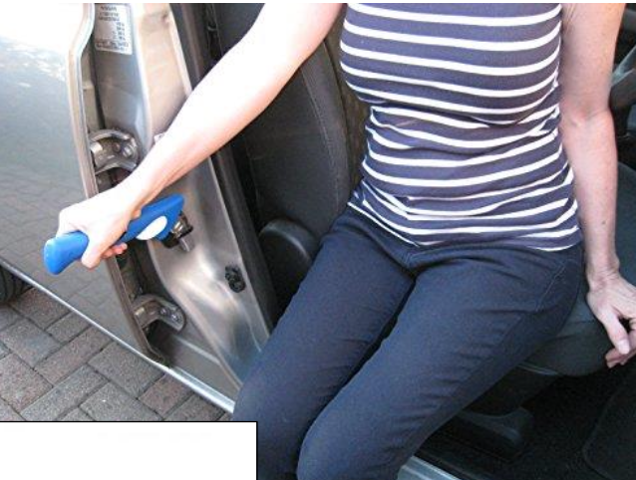

TRANSFERS
Seat Belt Extender
hard plastic type
(Amazon)
Car Assist Handle
(Amazon)

Slide 14

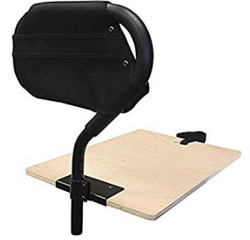
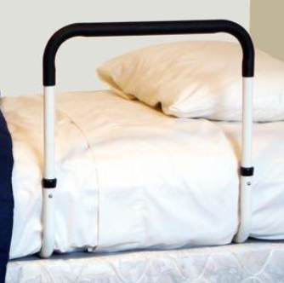

BED MOBILITY
Bed Cane
(Amazon/Google Shopping)
Silk/satin pajamas OR sheets
(Amazon)

Slide 15
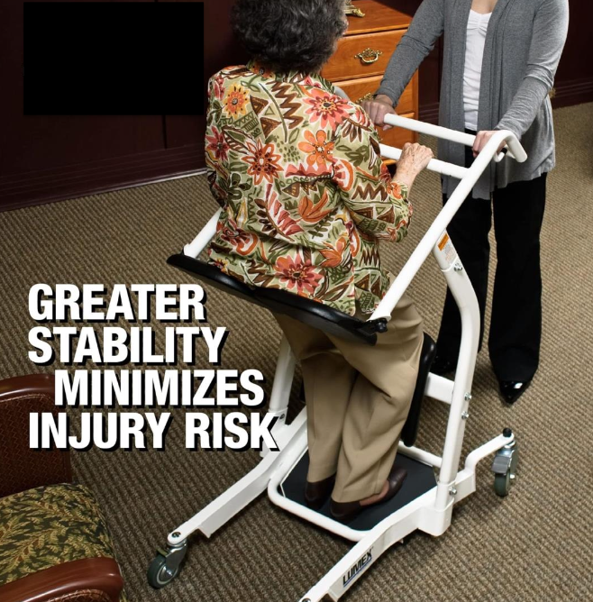
BED MOBILITY
Sit-to-Stand Device
(Amazon/Google Shopping)
Insurance doesn’t cover these, check out your local lending closet.

Slide 16
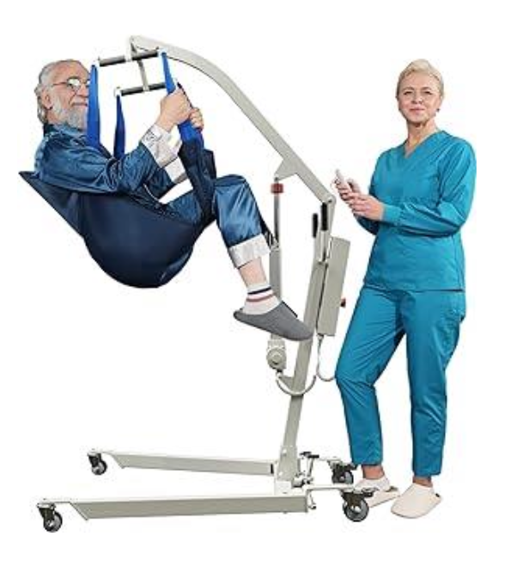
BED MOBILITY
Hoyer Lift
(Amazon/Google Shopping)
Insurance may cover these with the proper documentation from your physician and recent face-to-face visit.
Also check out your local lending closet.

Slide 17
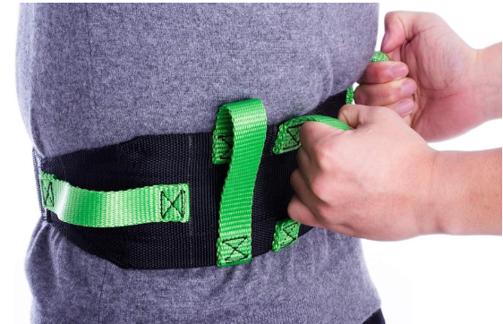
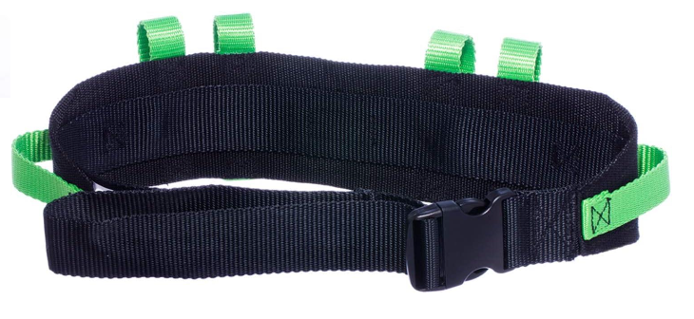
GAIT BELTS
Cow&Cow Gait Belt
(Amazon/Google Shopping)
Be sure to check out the sizing guide before purchasing.
These also can be used in the shower.

Slide 18
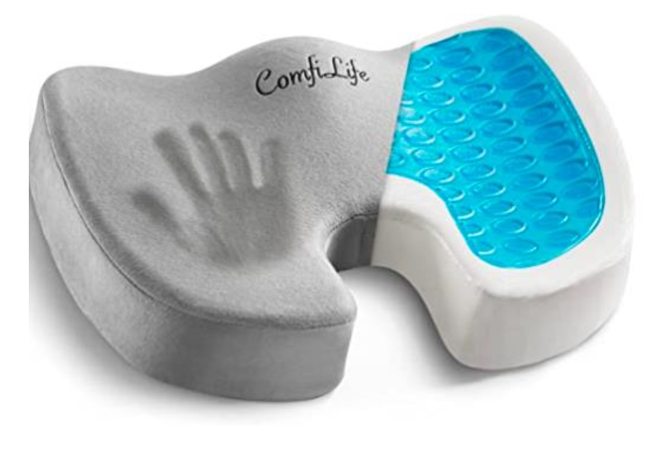
SEATING
Sacral Gel Pillow
(Amazon/Google Shopping)

Slide 19
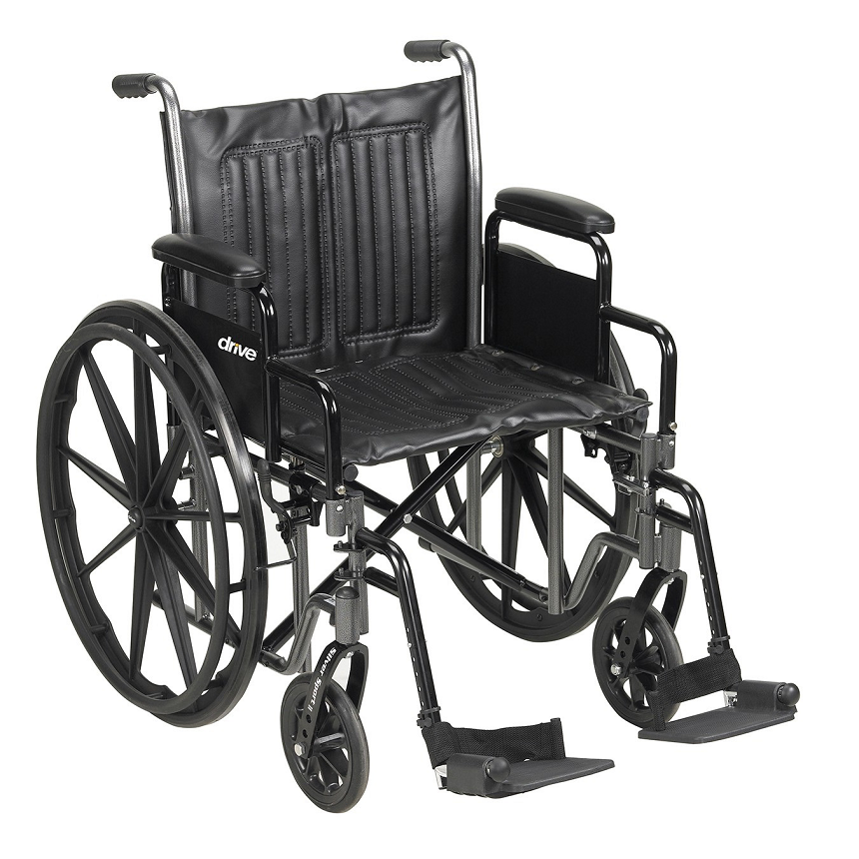
OUT & ABOUT
Transport Wheelchair
Easy to put in & out of vehicle and for short distances/trips
NOT meant to be a daily use/all-day wheelchair
Dumb Medicare Rule #1: Medicare covers only ONE wheelchair every five years (similarly, only ONE walker every five years)
                SO… buy a transport chair out of pocket, borrow one, or contact a lending closet
          DON’T spend Medicare $$ on this; save that for a better chair in case you need it!

Slide 20
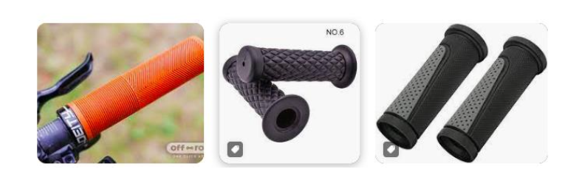
OUT & ABOUT
Trick out your wheelchair, it will help with your caregiver’s hands!
                Take your transport (or daily) wheelchair to a BIKE SHOP
                Ask the owner/staff to remove the hand plastic grips and replace them with ergonomic, comfy bike handlebar grips. They may need to use a box cutter to remove the old ones, and hair spray on inside of new grips to slide over metal bar.

Slide 21
Dressing, Bathing, & Other Activities Of Daily Living

Slide 22
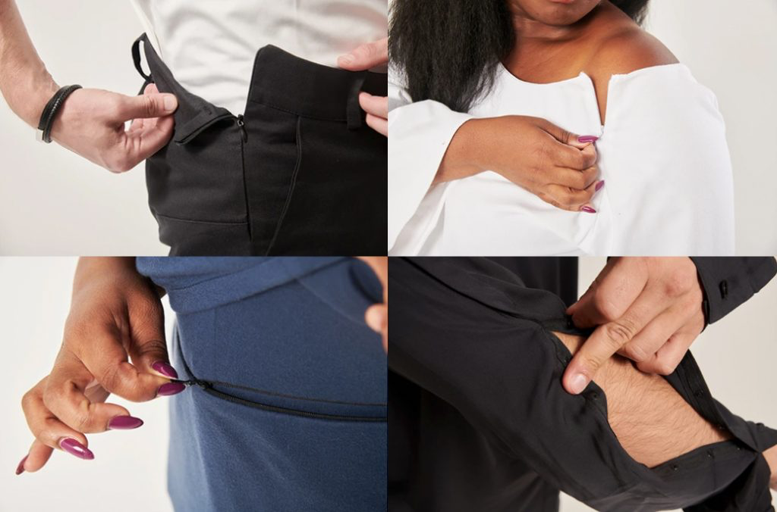
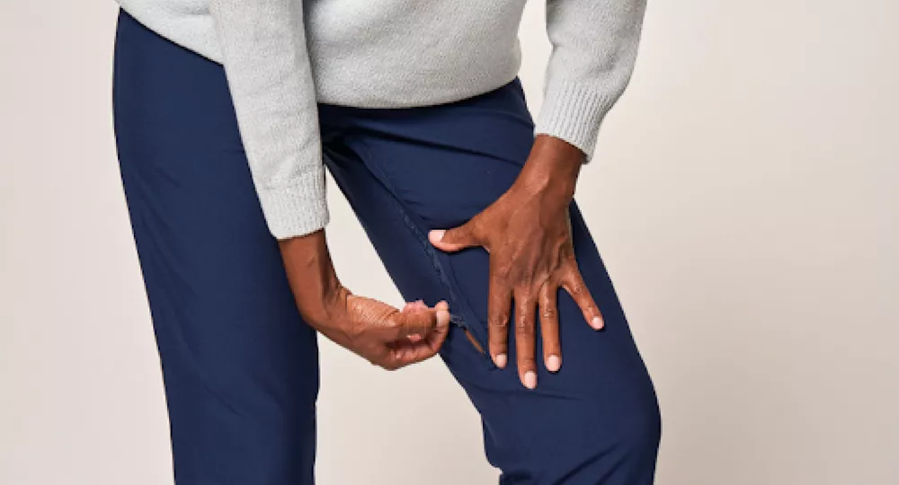
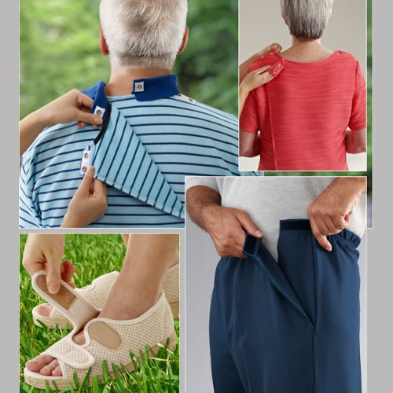
DRESSING
Adaptive Clothing
(Amazon/Target)
Or check out these websites…
Magnaready.com
Silverts.com
Joeandbella.com
Izadaptive.com
Ovidis.com
JCPenny.com

Slide 23
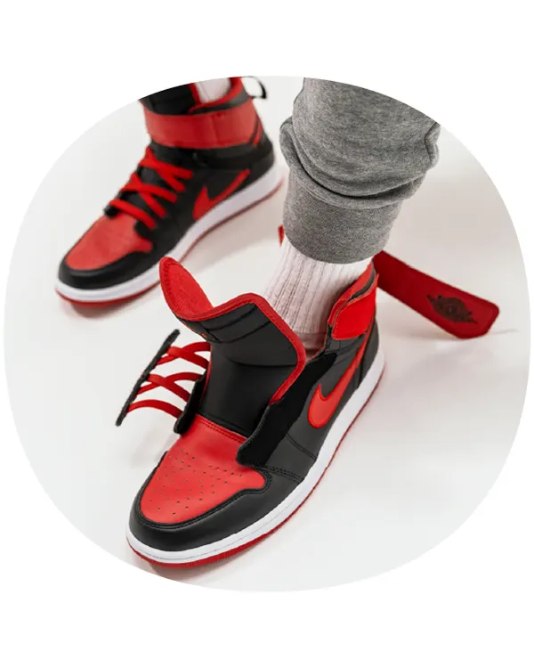
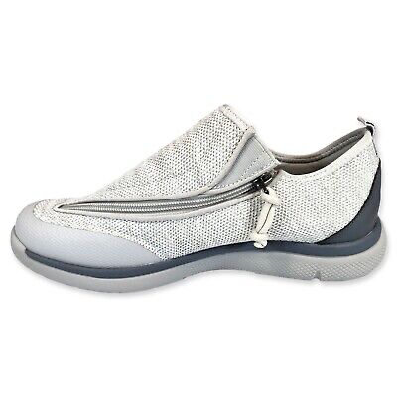
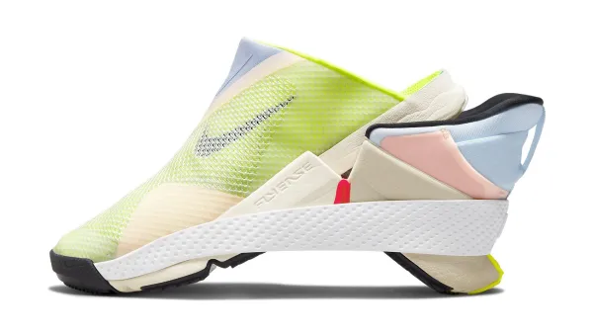
FOOTWEAR
Zeba.com
Kizik.com
Nike.com: Nike Go
FlyEase
BOTH have men’s and
women’s shoes; sneakers
& less casual

Slide 24

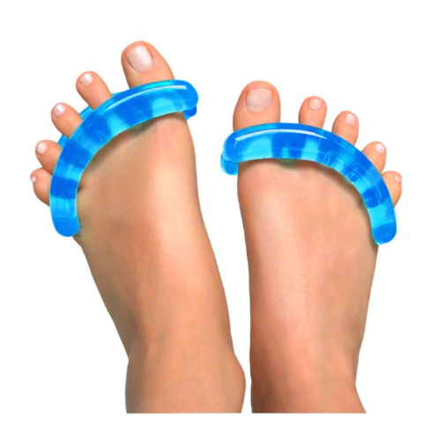
FOOT CRAMPS
Buy a can of frozen juice concentrate
Make juice (or defrost & use for smoothie)
Refill can with water and freeze upright
When soles of feet are cramping, press and roll sole of foot over frozen can
Refreeze & repeat
**Tennis ball is similar, just missing cold benefit**
or try YogaToes!

Slide 25

ORAL HYGIENE

Slide 26
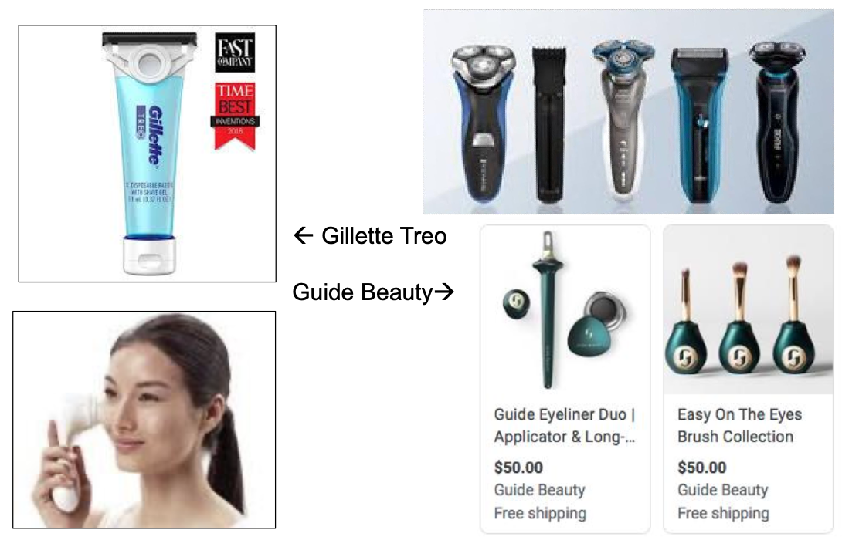
HYGIENE
←
Gillette Treo
Guide Beauty
→

Slide 27
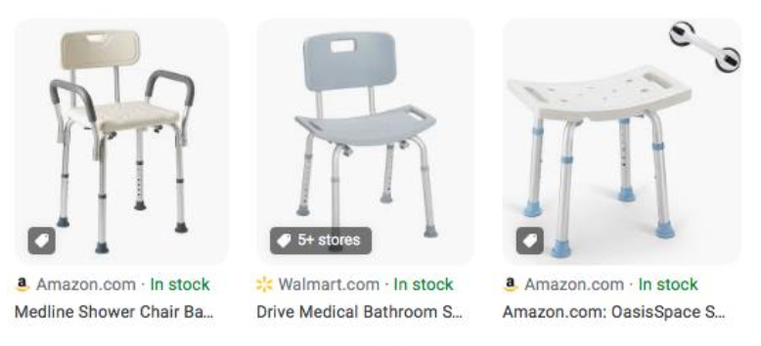
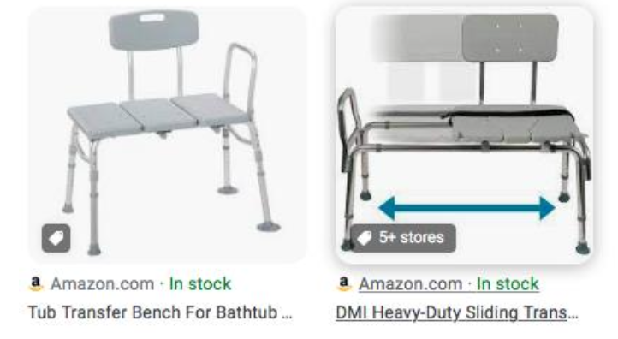
BATHING
Shower Chair
←
Shower Bench/
Tub Transfer
→

Slide 28
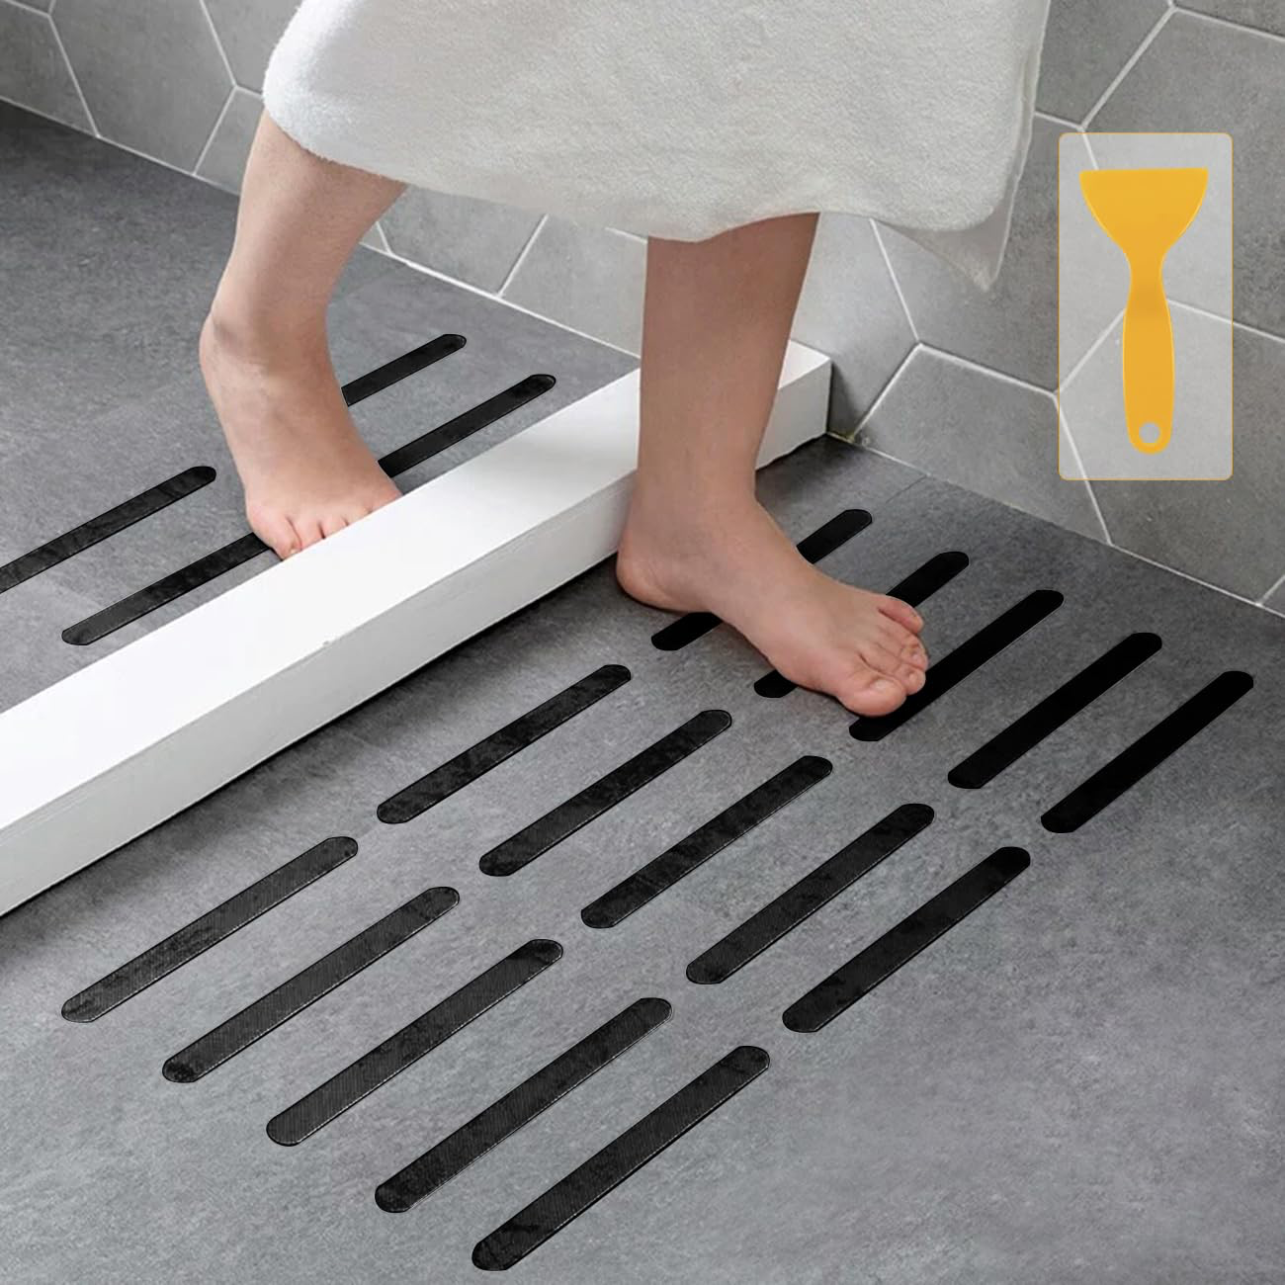
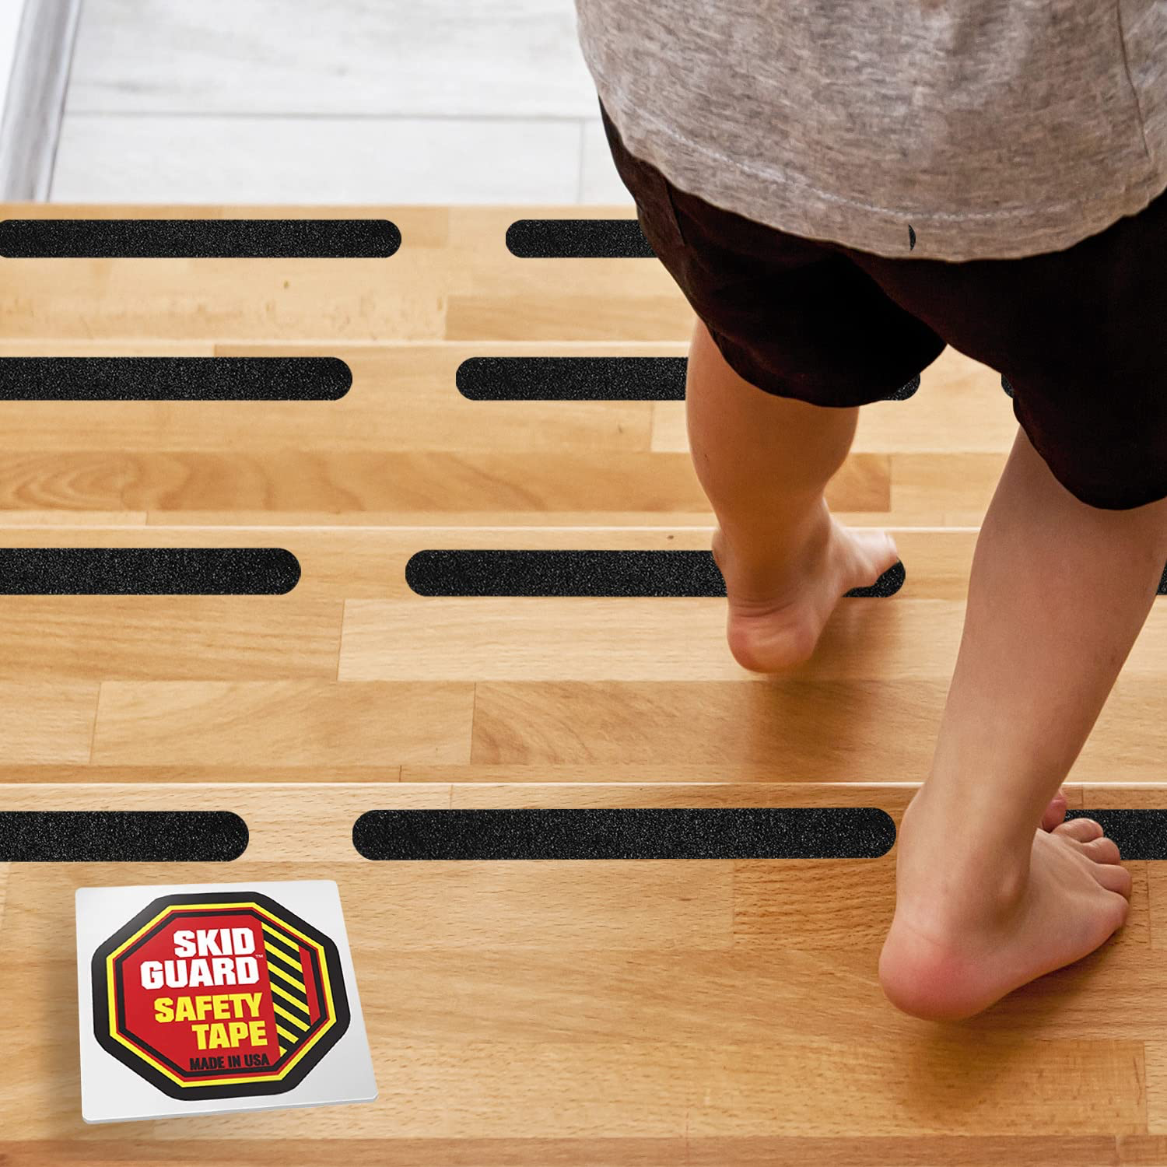
BATHING
Non-Skid Tape
(Amazon)
→
Use for bath or throughout the home.
TIP: Use brightly colored skid tape for better viewing!

Slide 29
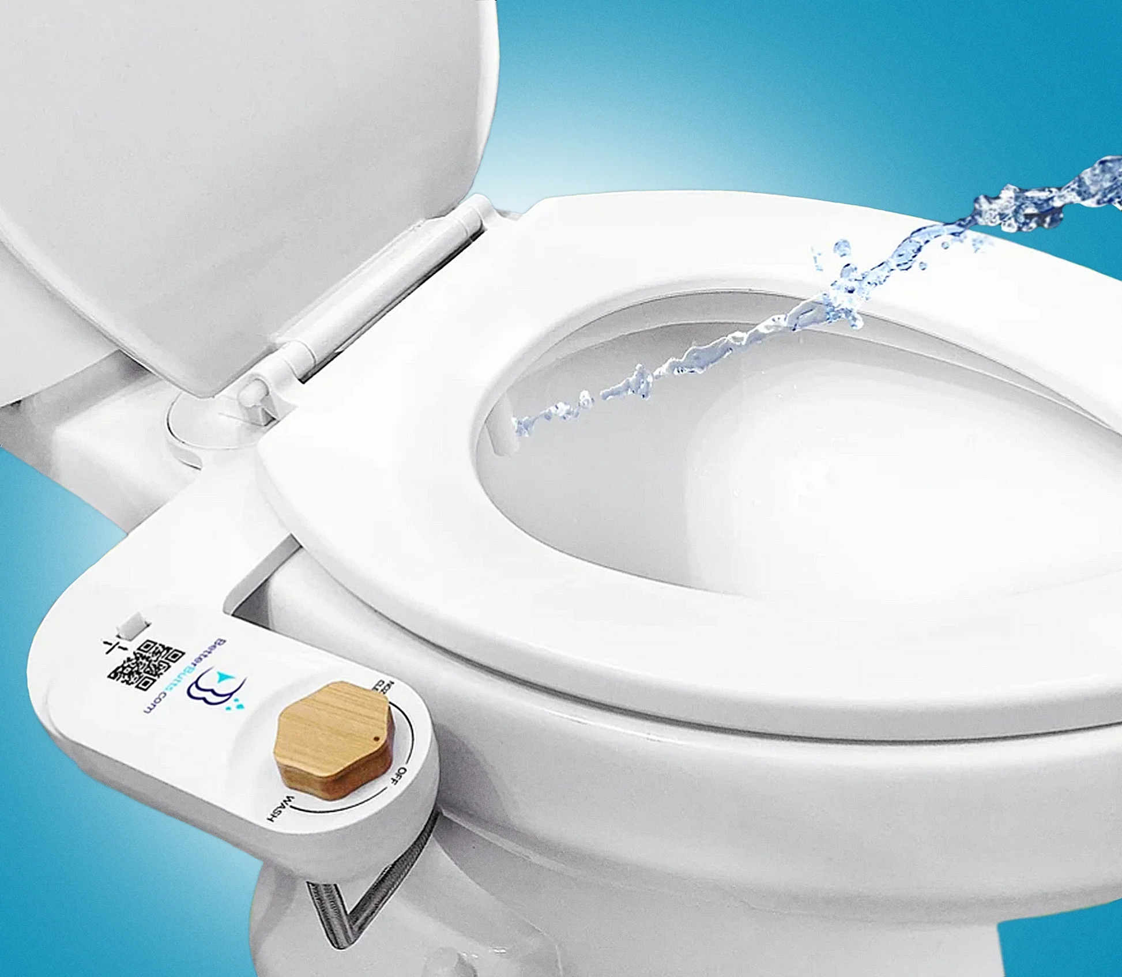
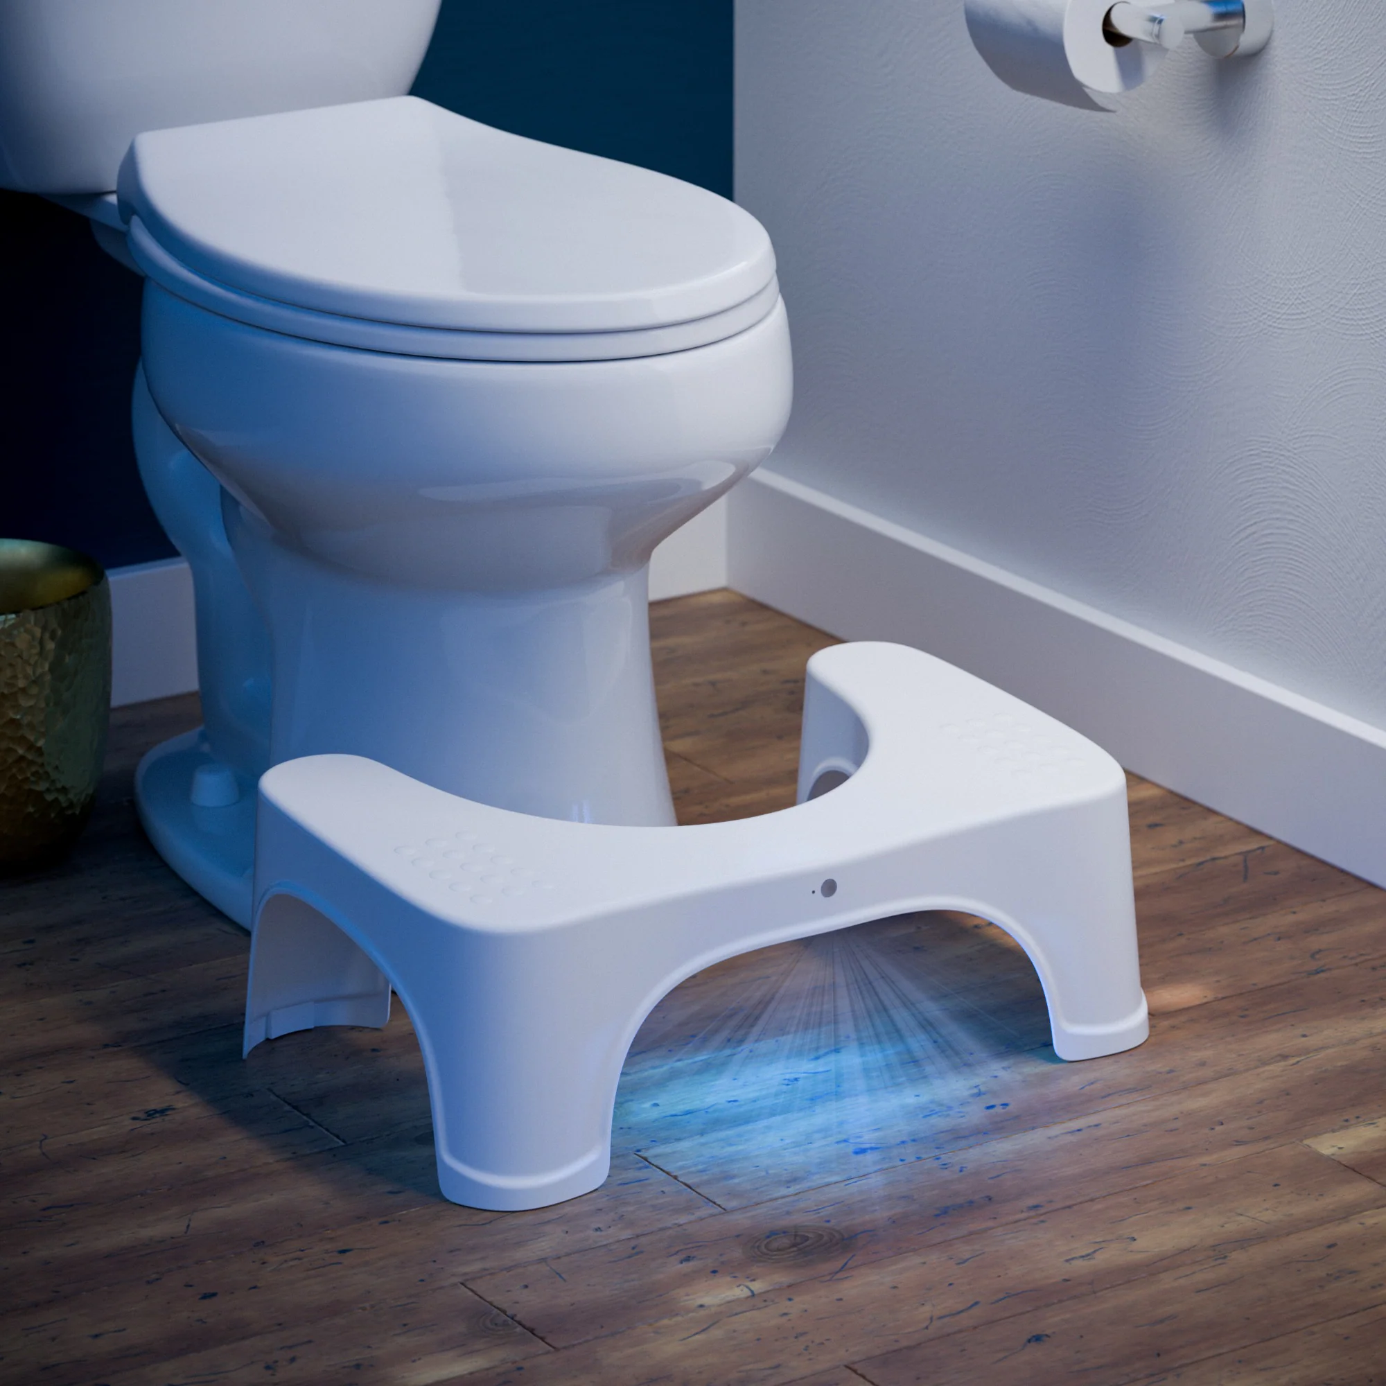
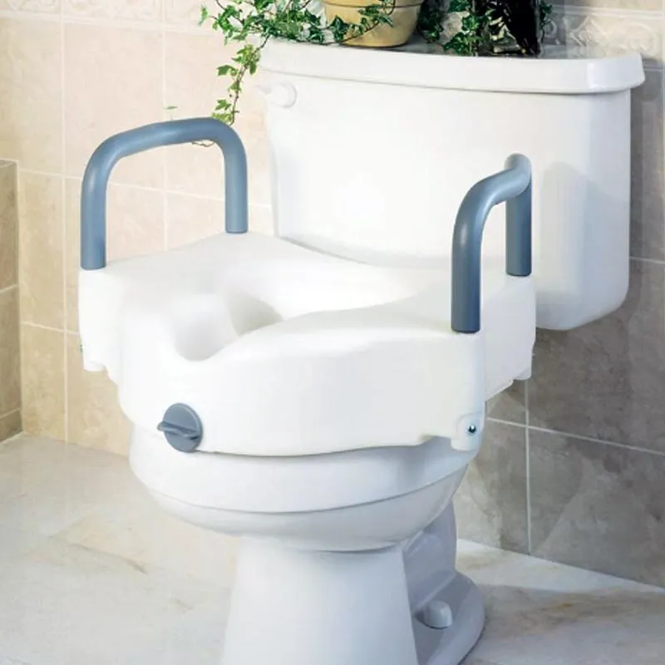
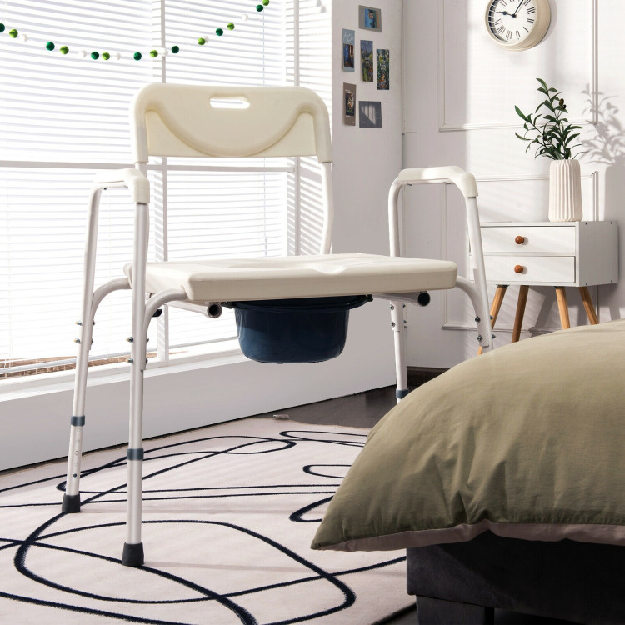
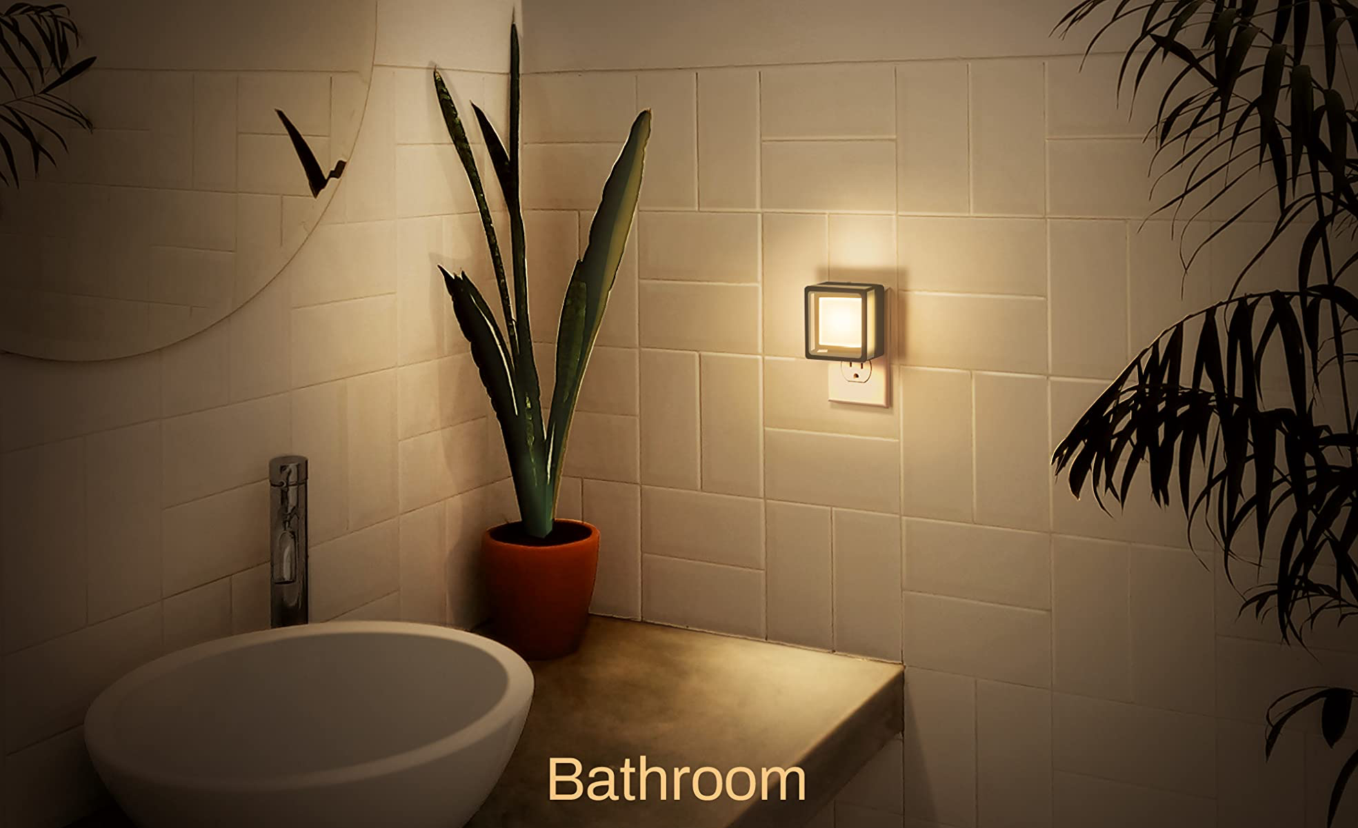
TOILETING
Bidet
Squatty Potty
Raised Toilet Seat
Bedside Commode
Use these lights for these bathroom or throughout the home!

Slide 30

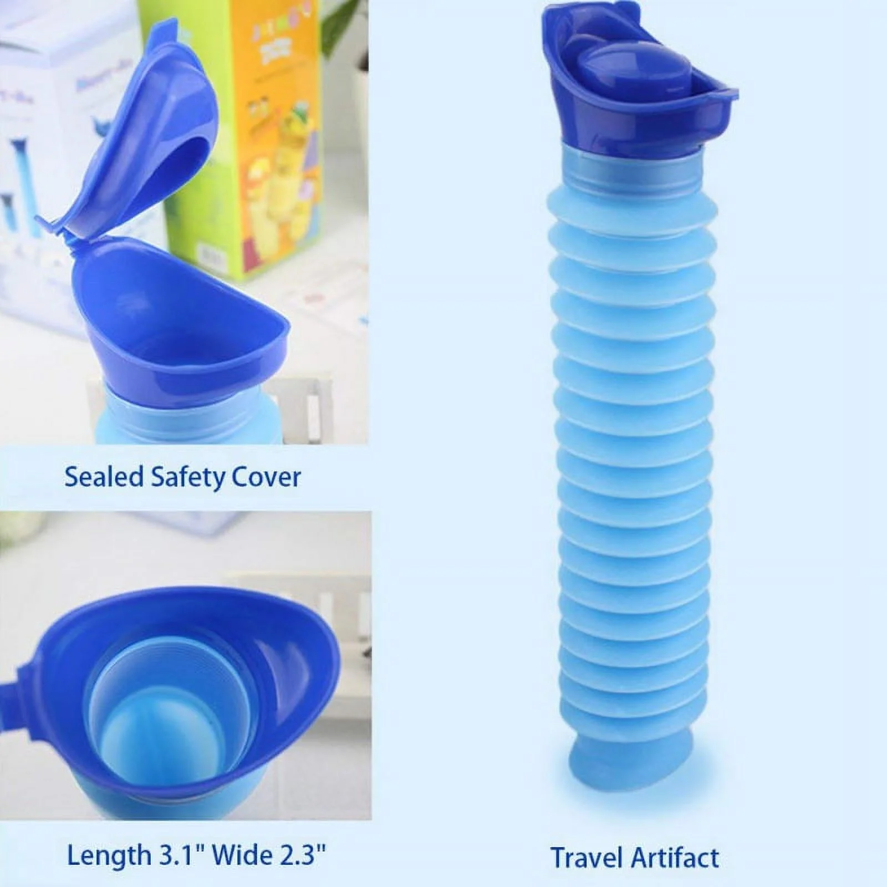
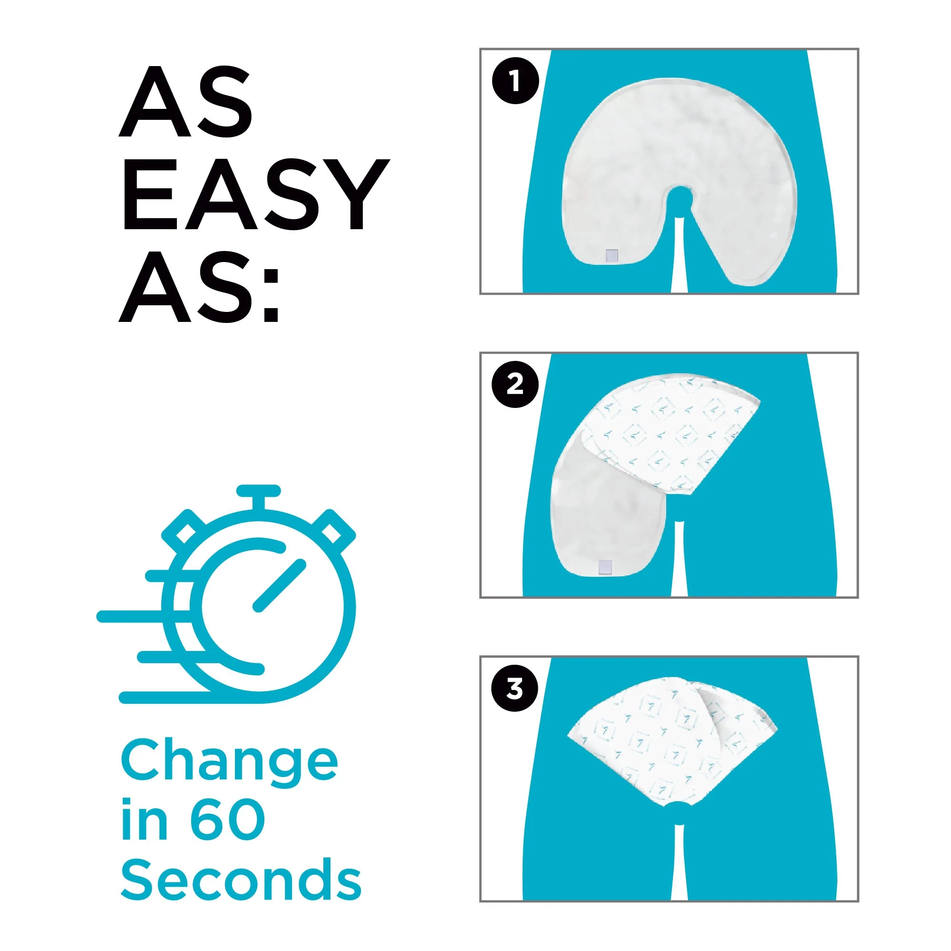
TOILETING
(MEN’S EDITION)
Quick
Change
(Walmart)
Portable Urinal
(Walmart/Amazon)

Slide 31
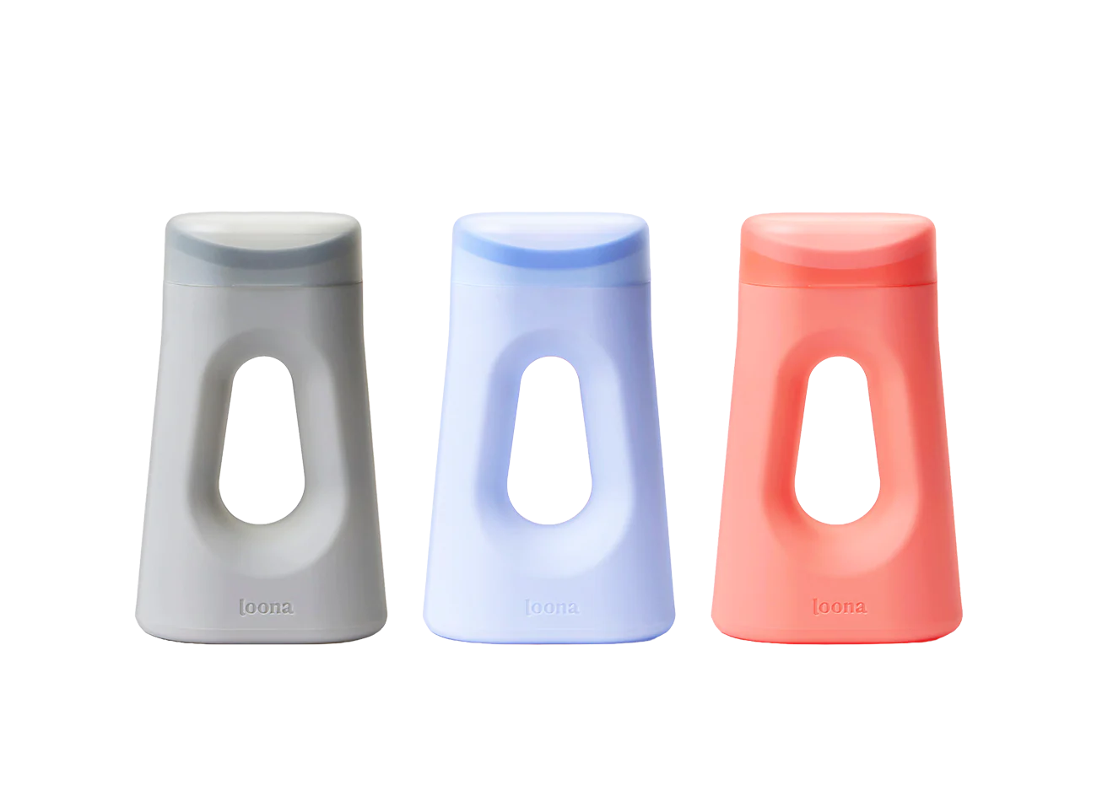
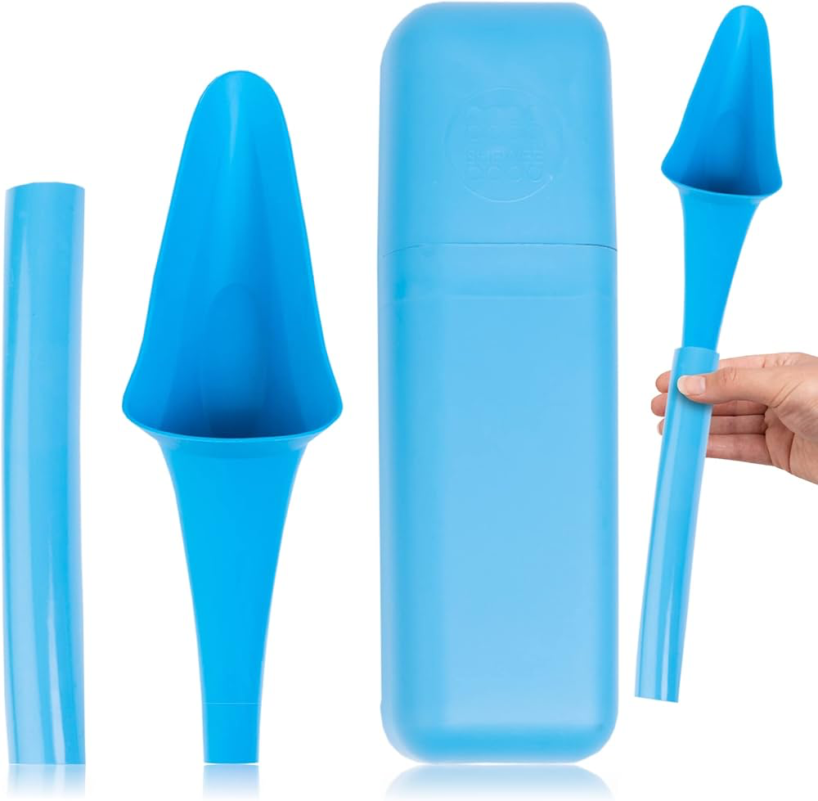
TOILETING
(WOMEN’S EDITION)
Loona Portable Urinal
(Target/Amazon)
SheWee
(Amazon)

Slide 32
Medication Adherence

Slide 33
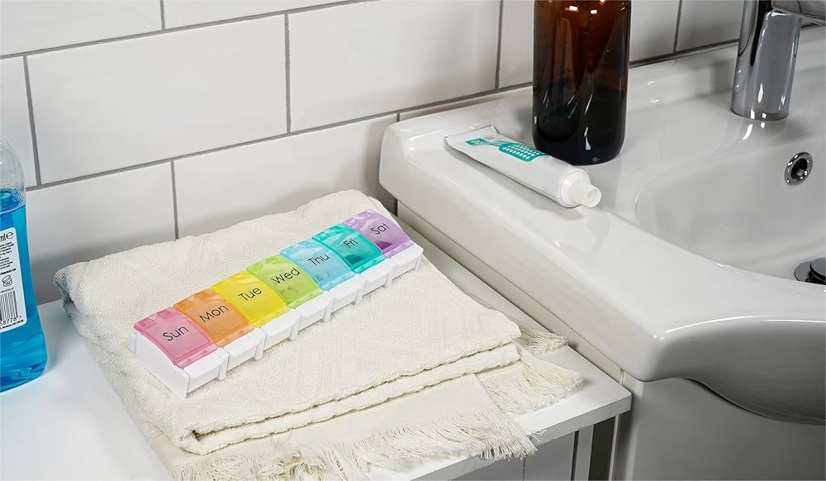
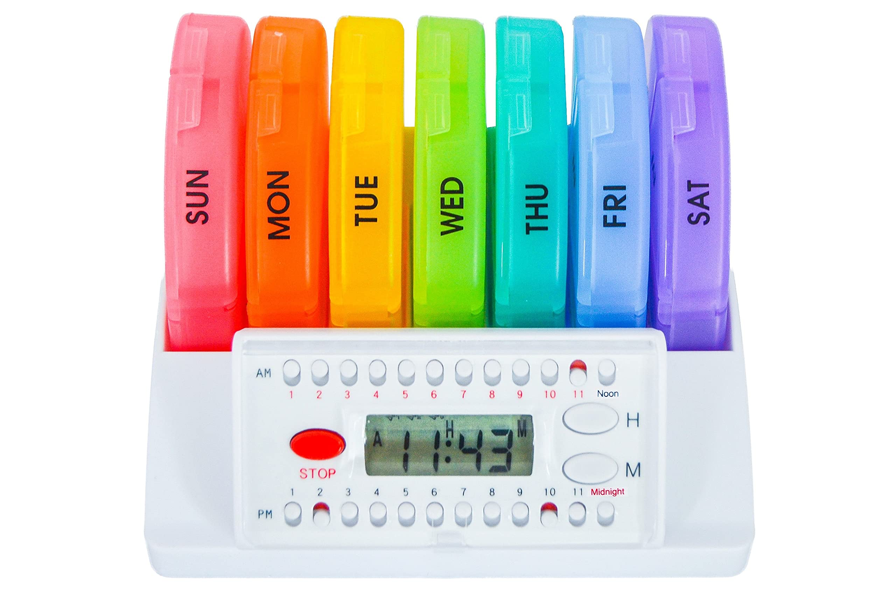
MEDICATION ADHERENCE
Link each dose with a regular activity, keep pills in those locations:
  Brushing teeth
  Making coffee
  Reading the paper
Set reminders (ex: sticky note reminders
in specific locations)
  Pillboxes with built-in alarms
    e-Pill 4 Alarm Pill Box
    Organizer with Vibration Reminder
    Med-E-Lert Pill Box dispenser

Slide 34
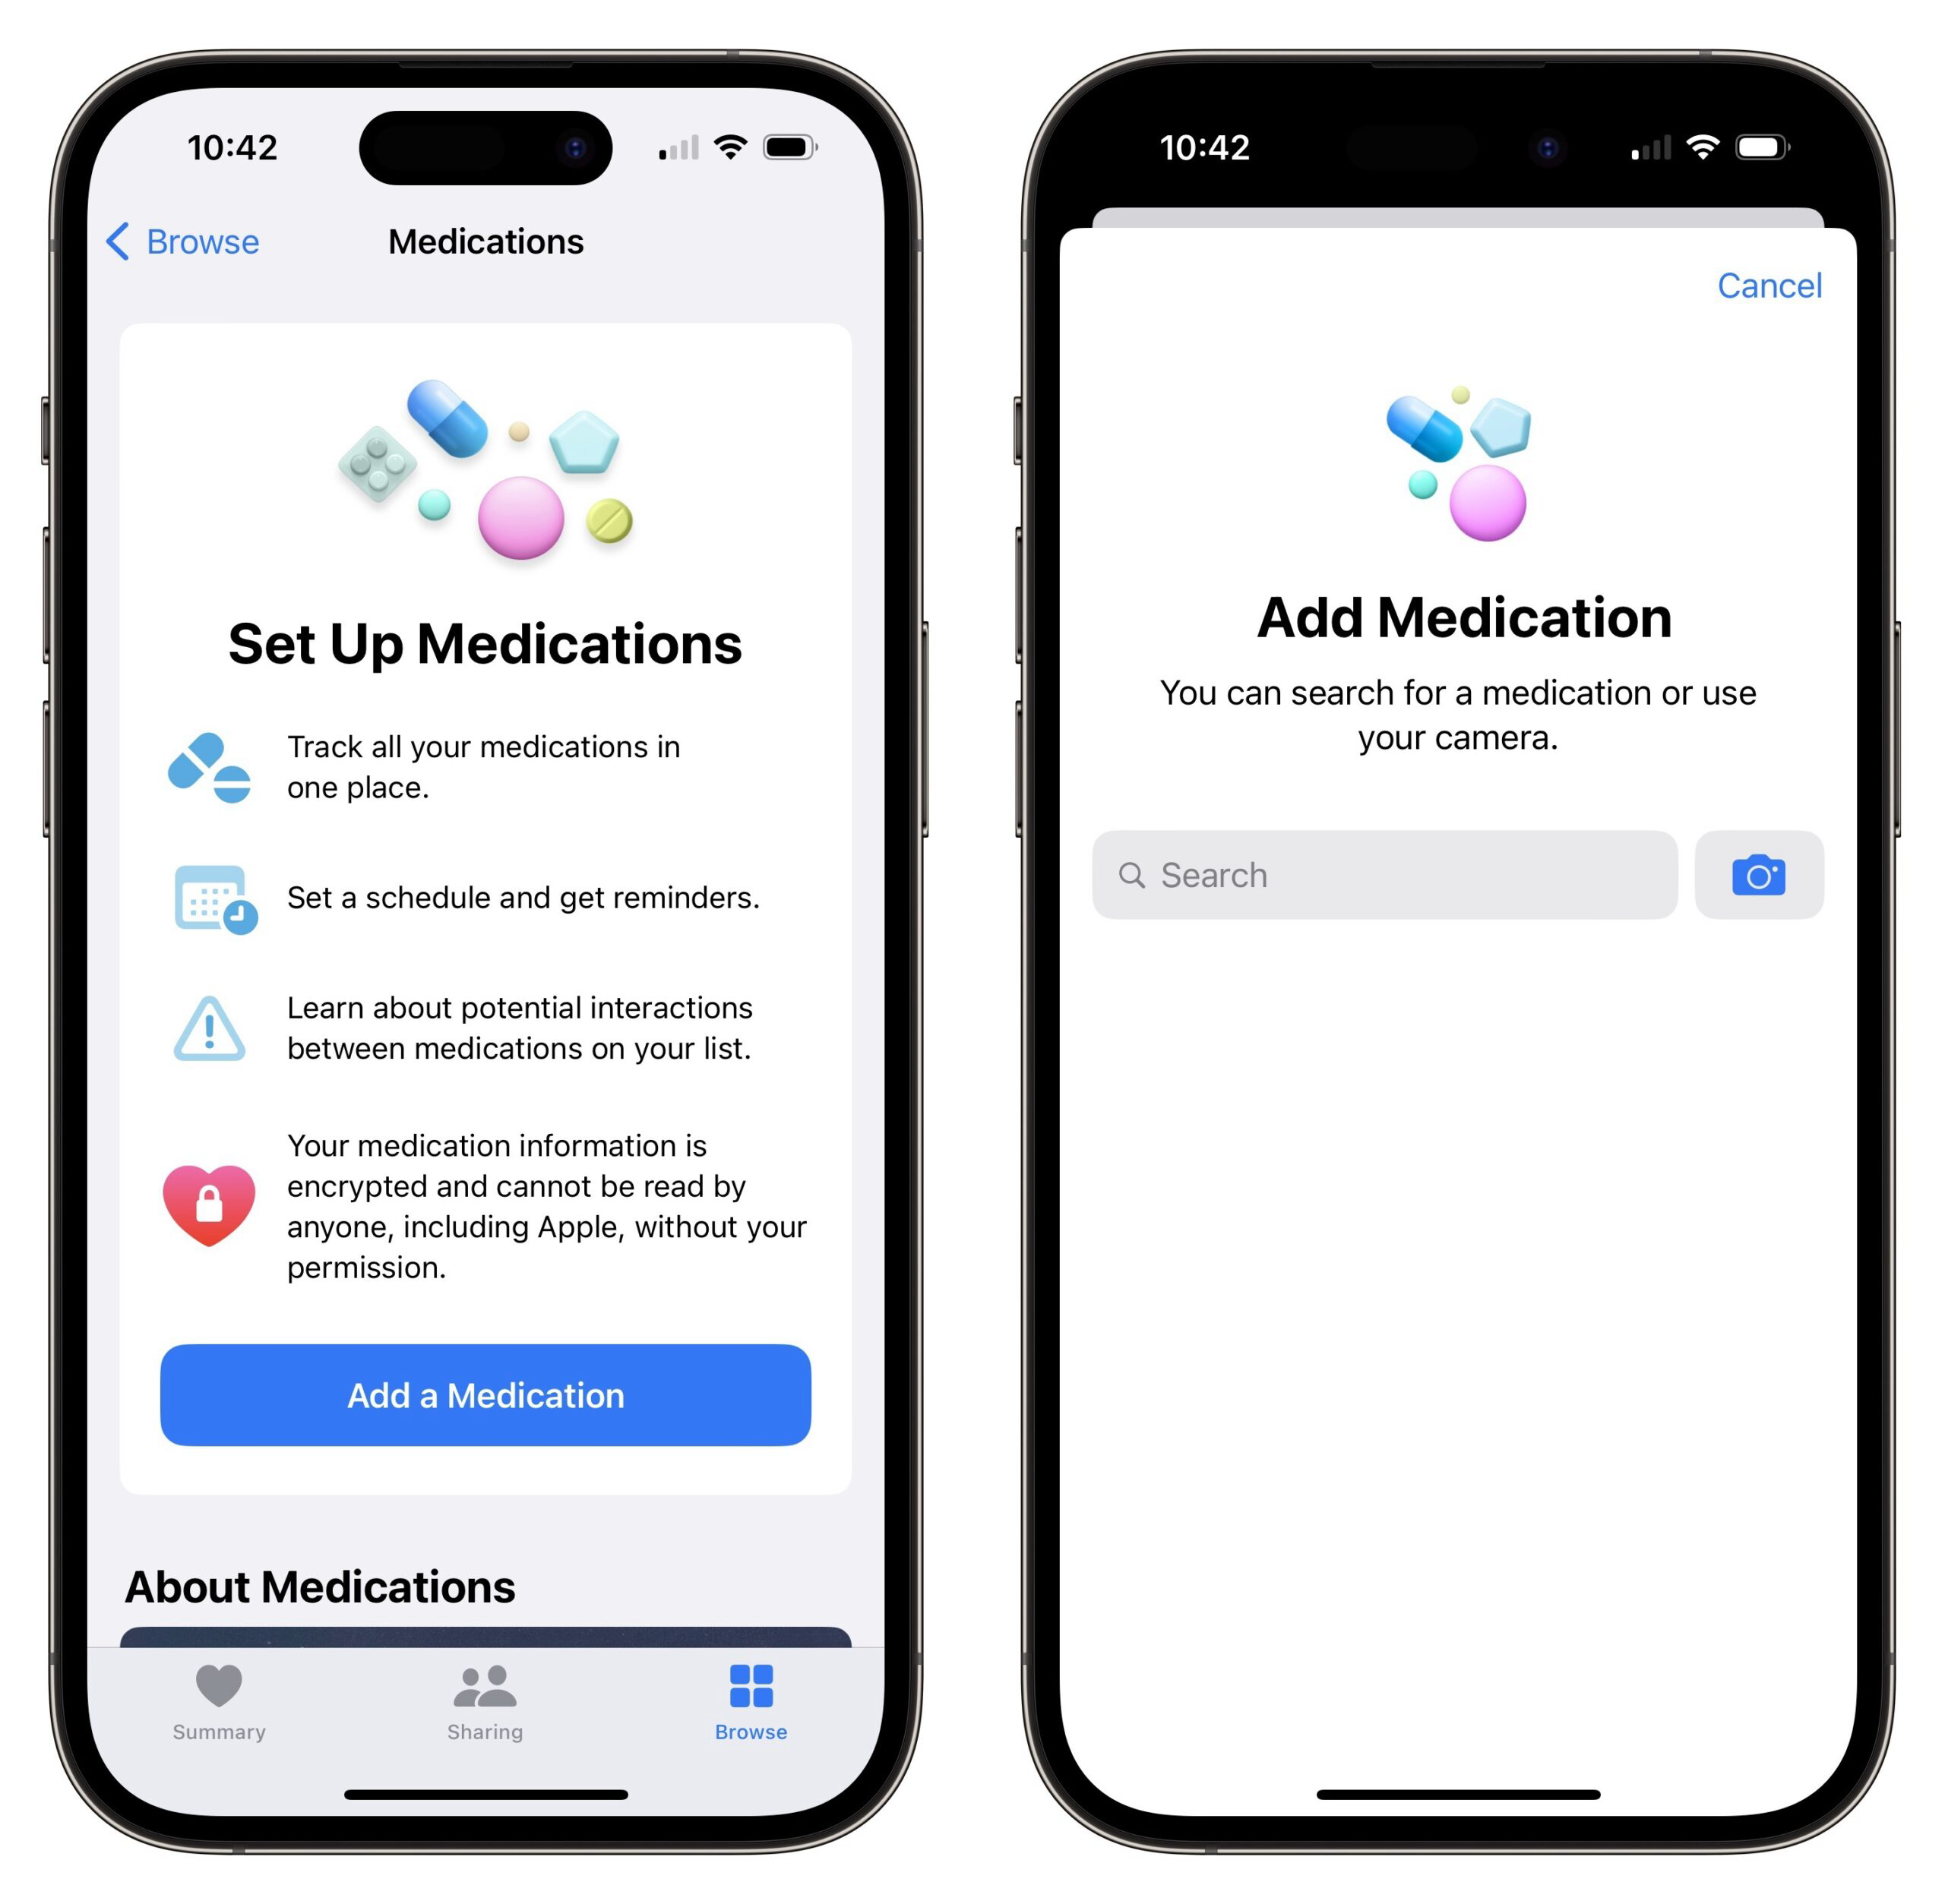
MEDICATION ADHERENCE
Set phone alarms:
  Most cellphones (including flip phones) can handle at least 3 alarms daily
  Multiple alarms, can each be set & labeled for different medications
  Tip: Use different ringtones for different medications
Use your smartphone:
    Reminders app
    Medication (in Health settings)
    Free pill reminder apps (ex: MedHelper, MedSimple, MediSafe)

Slide 35

MEDICATION ADHERENCE
Keep an emergency supply in your purse or wallet, glove compartment, carry-on bags
Bring medications with you to the hospital
Ask an occupational therapist for other ideas tailored to your life

Slide 36
Food Preparation,
Eating, & Hydration

Slide 37
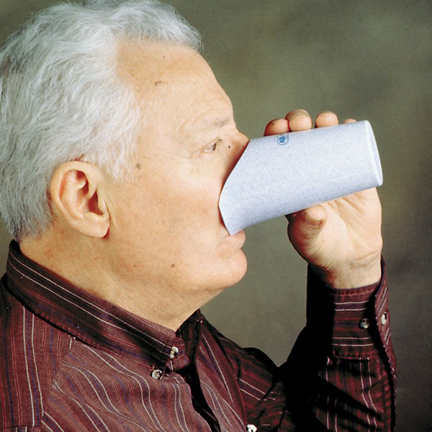


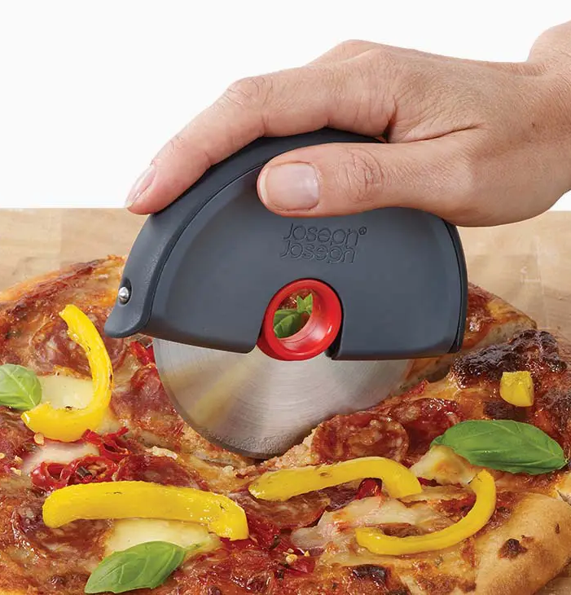
EATING
Nosey
Cup
Weighted
Utensils
Silicone
Placemats
Pizza Cutter
or Mezzaluna

Slide 38
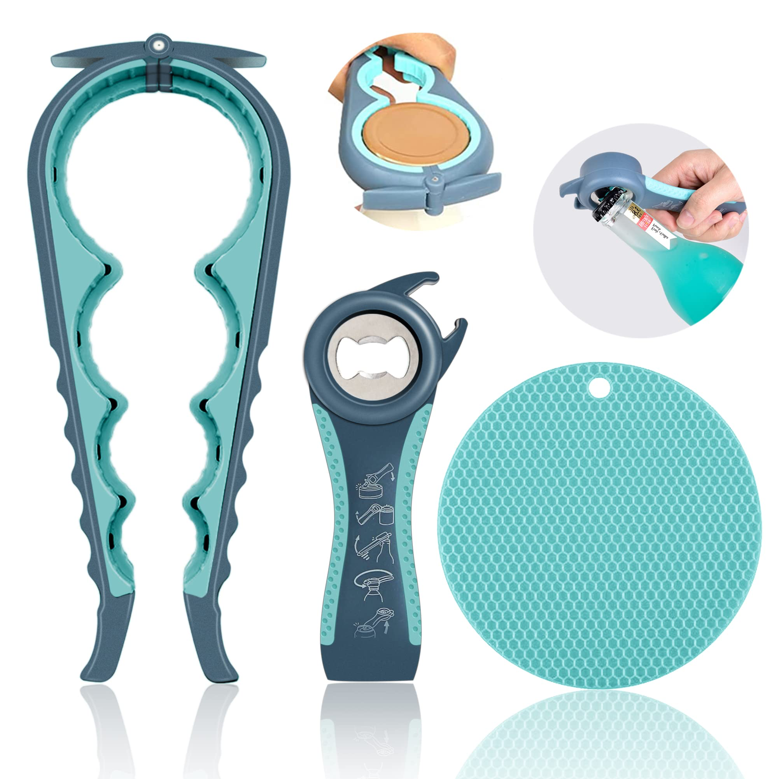


EATING
Rimmed
Plate
One-Touch
Opener
Easy Grip
Jar Opener

Slide 39


STAY HYDRATED!
      WHY
        People with Parkinson's are at higher risk of dehydration
        Dehydration → Confusion, UTI, fatigue, lightheadedness, dizziness, falls, and constipation
      HOW
        Hot or iced tea, decaf coffee
        “Spa water” with fruit slices or herbs
        Crystal Light, Mio, Dasani, Kool Aid
        ALL THE FRUIT! (except bananas)
        Water bottle you like: size, shape, grip, gulp, cleanabilities, etc.

Slide 40
WE LIVE IN COMMUNITY. WE DESIRE KNOWLEDGE. AND WE LIVE WELL WHEN INFORMED, CONNECTED, AND INSPIRED.
THANK YOU!

